Slide 1
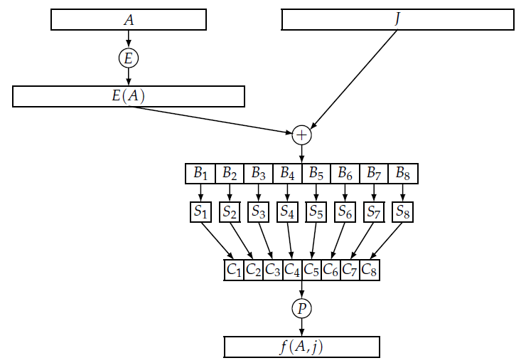
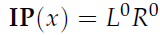
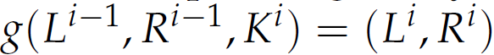
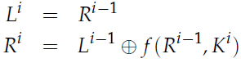
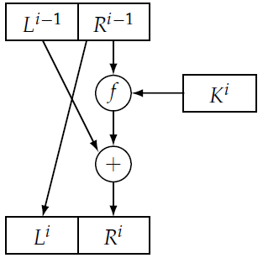
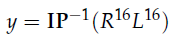
Homework 3
4.3 Suppose y = DES(x, K) and y’ = DES(c(x), c(K)), where c(·) denotes the bitwise complement of its argument. Prove that y’= c(y).
Answer:
f(A,J) = f(c(A), c(J))

Slide 2
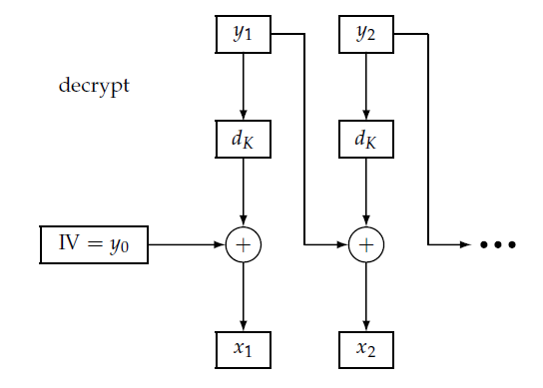
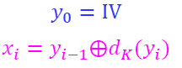
Homework 3
4.6 Prove that decryption in CBC mode can be parallelized efficiently. More precisely, suppose we have n ciphertext blocks and n processors. Show that it is possible to decrypt all n ciphertext blocks in constant time.
Answer: For CBC mode
y_{i}
x_{i}
d_{K}
y_{i-1}

Slide 3
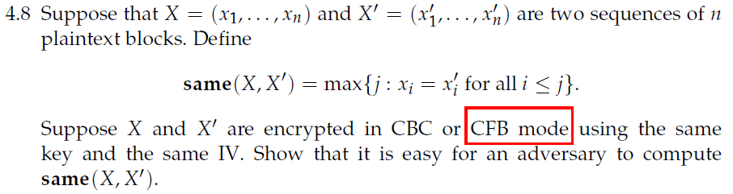
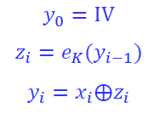
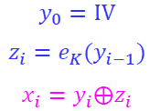
Homework 3
Answers: For CFB mode,
If the same key and the same IV are used, then it is easy to compute the following value from the ciphertexts Y and Y’ as
same(X, X’) = same(Y, Y’)

Slide 4
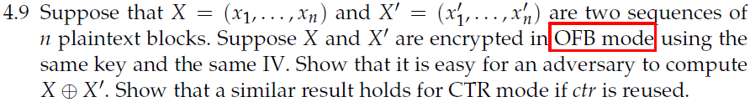
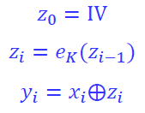
Homework 3
Answers: For OFB mode,
If the same key and the same IV are used, then the same sequence of z_{i} is obtained. Hence it is easy to compute X⊕X’ since
y_{i}⊕y’_{i} = x_{i}⊕z_{i}⊕ x’_{i}⊕ z_{i} = x_{i}⊕ x’_{i}

Slide 5
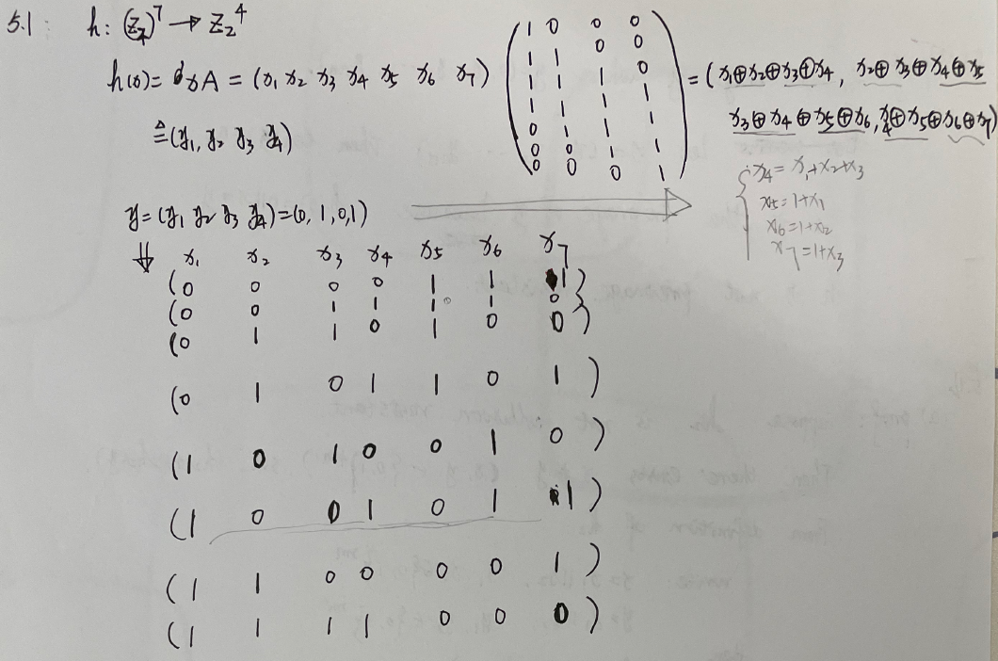
Homework 4

Slide 6
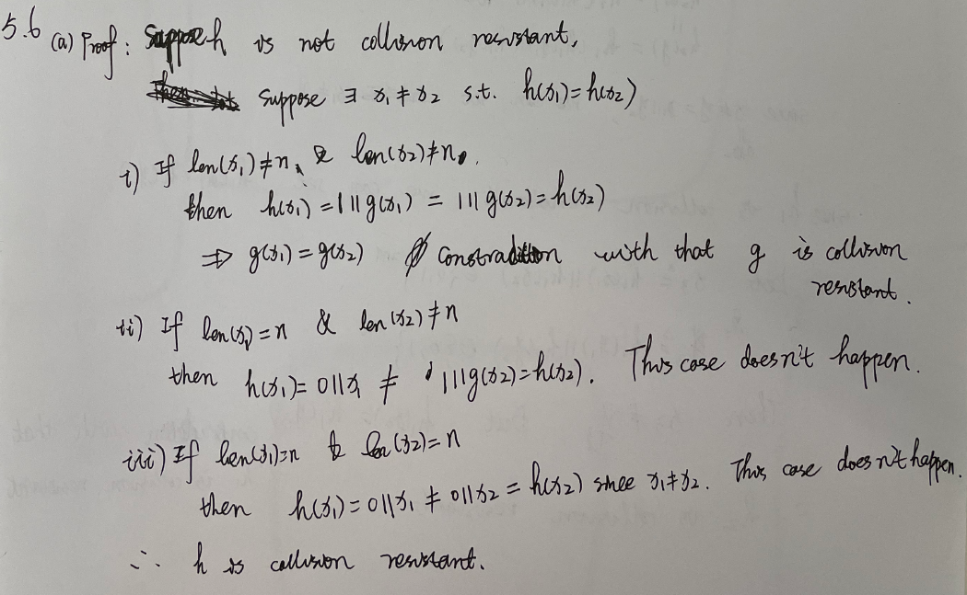
Homework 4

Slide 7
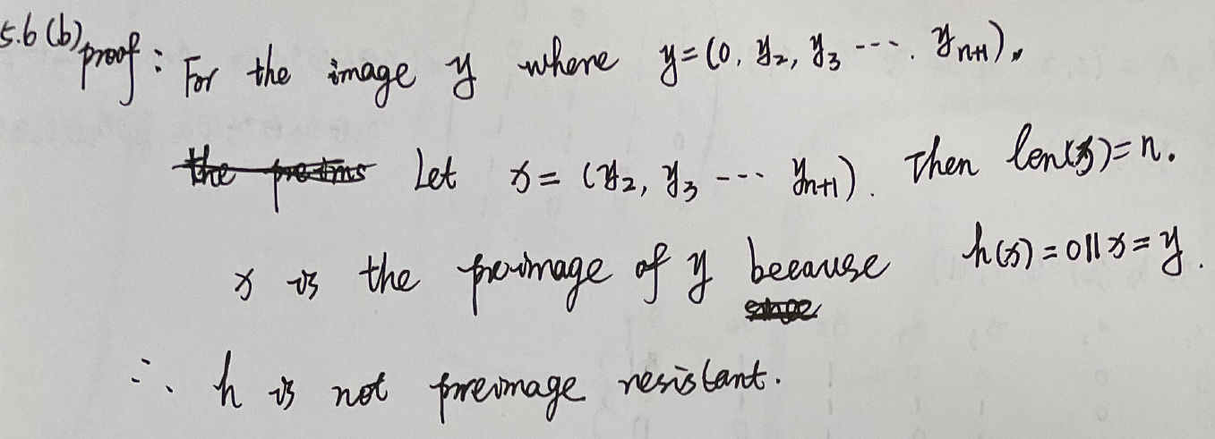
Homework 4
In the set of all possible message digests {y=(y₁, y₂, y₃, …, y_{n+1})}， there are one half ys satisfying y₁=0, i,e., |{y=(0, y₂, y₃, …, y_{n+1})}|=2^{n}.

Slide 8
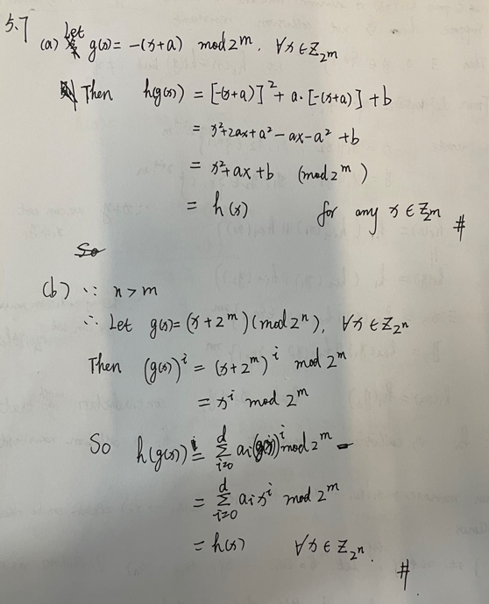
Homework 4

Slide 9
Homework 4
5.8 proof:
Let x₁=x’||x’’, x’ ≠ x’’ and x’, x’’∈{0,1}^{m} . Denote y= h(x₁)
Set x₂=x’’||x’.
Then x₁≠x₂ ，but h(x₁) = f(x’⊕x’’)=f(x’’⊕x’)=h(x₂).

Slide 10
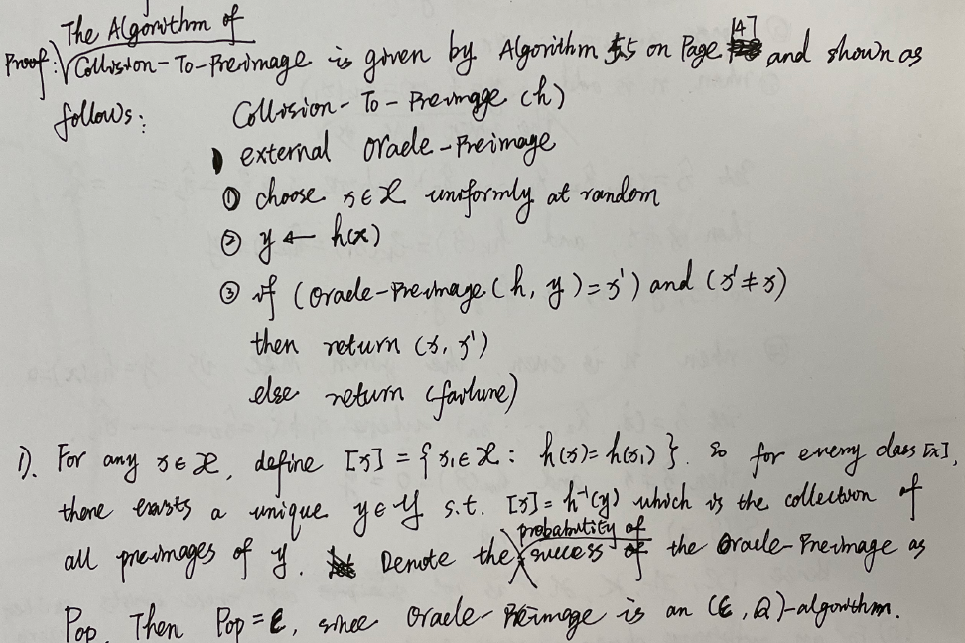
Homework 4
5.11

Slide 11
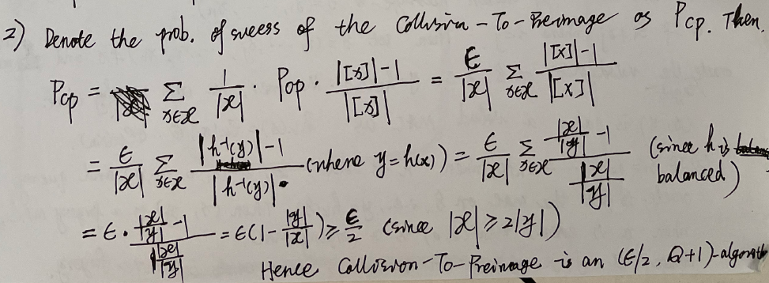
Homework 4
5.11

Slide 12
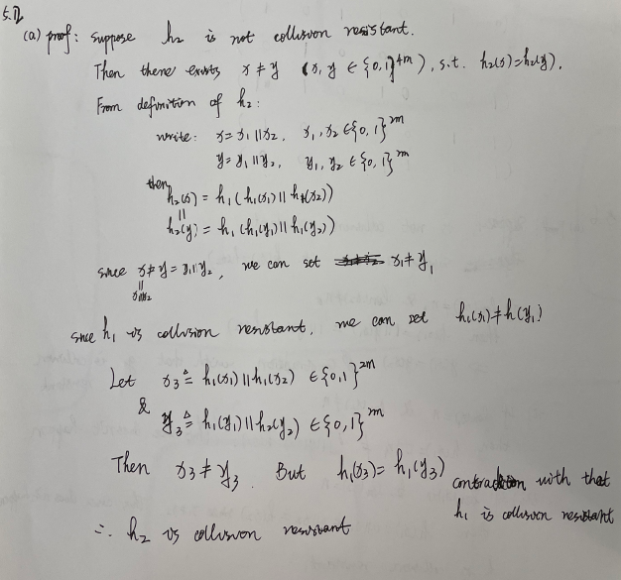
Homework 4
5.12

Slide 13
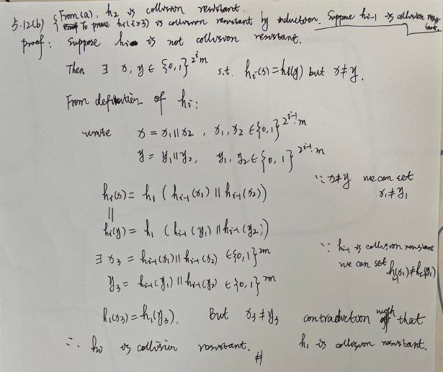
Homework 4

Slide 14
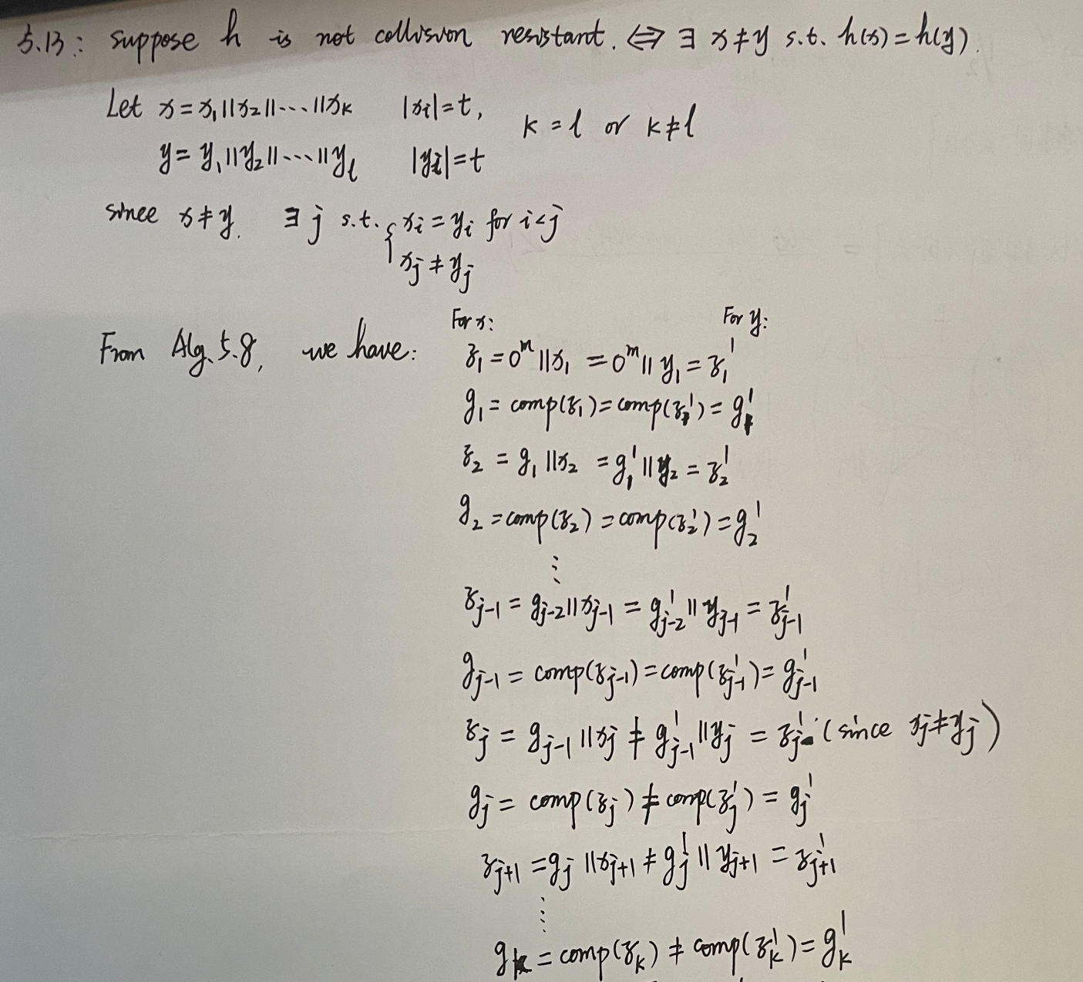
Homework 4
5.13
contradiction
h(x)=
=h(y)

Slide 15

Homework 4
5.14

Slide 16
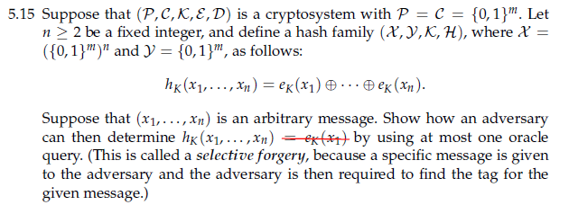
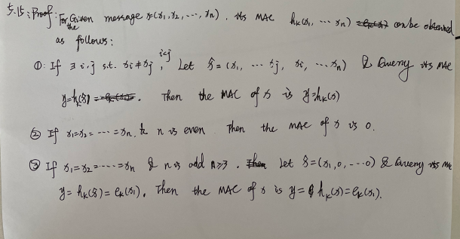
Homework 4

Slide 17
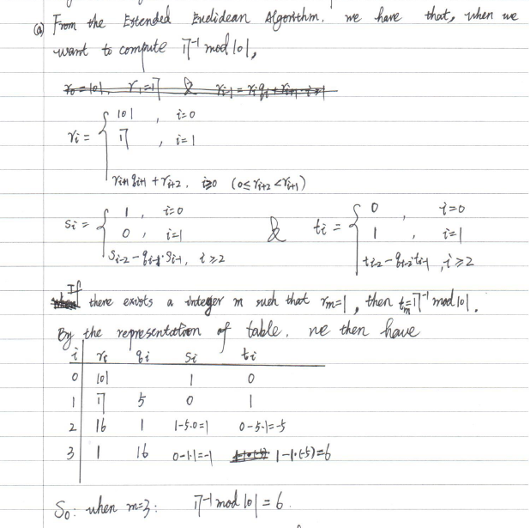
Homework 5
6.3 Implement the Extended Euclidean Algorithm (Algorithm 6.2) as the following tables
Set
then

Slide 18
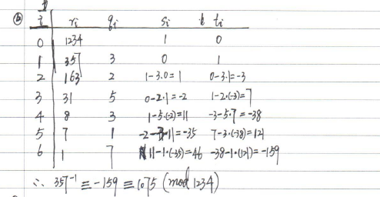
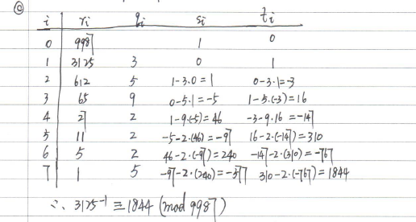
Homework 5
6.3

Slide 19
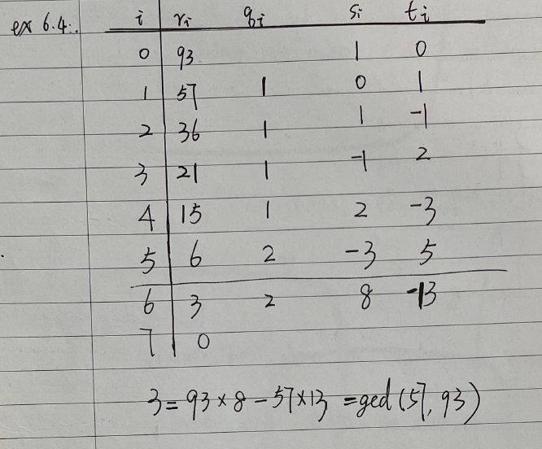
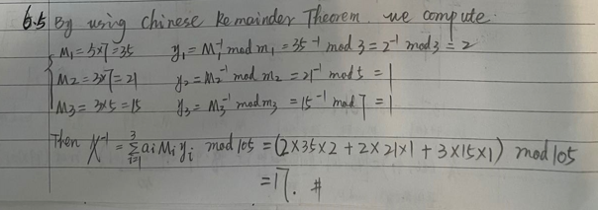
Homework 5
6.4
6.5

Slide 20
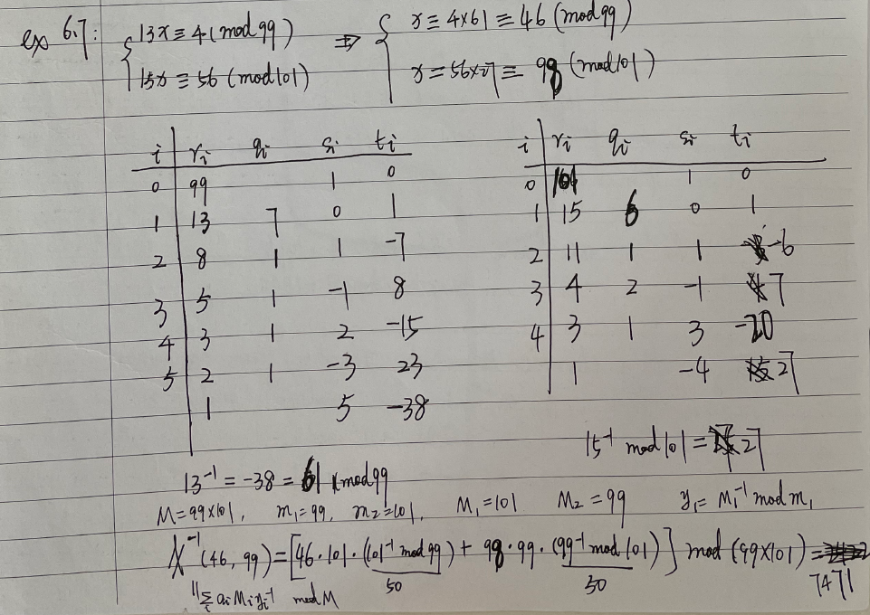
Homework 5
6.7
3
1
2
4

Slide 21
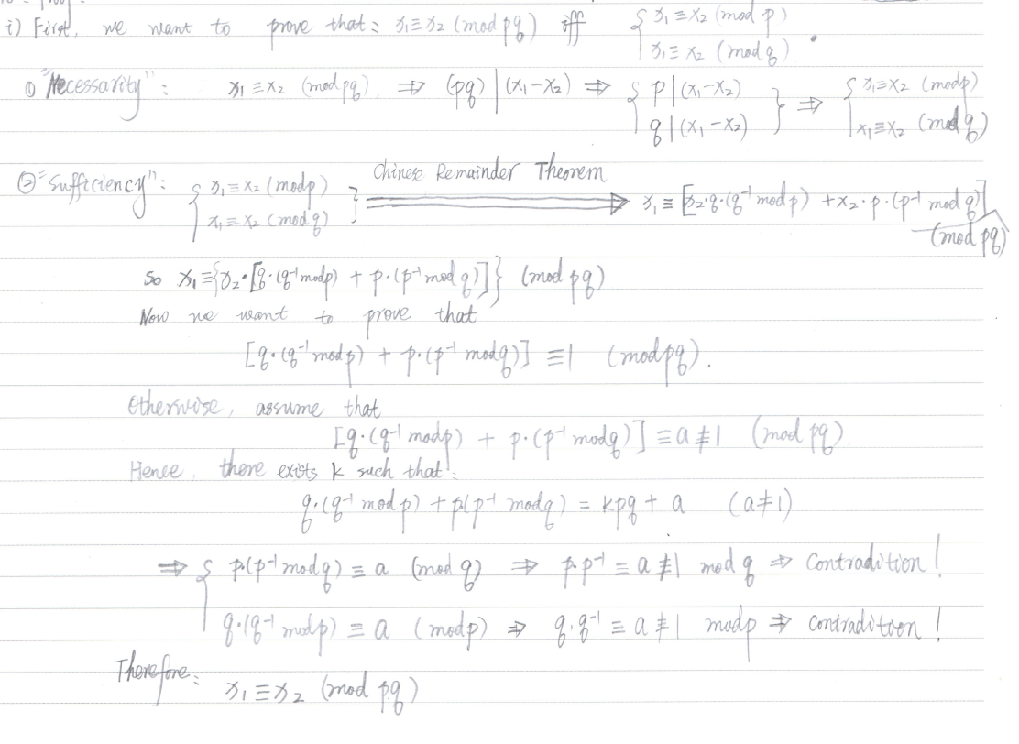
Homework 5
6.11 Proof:

Slide 22
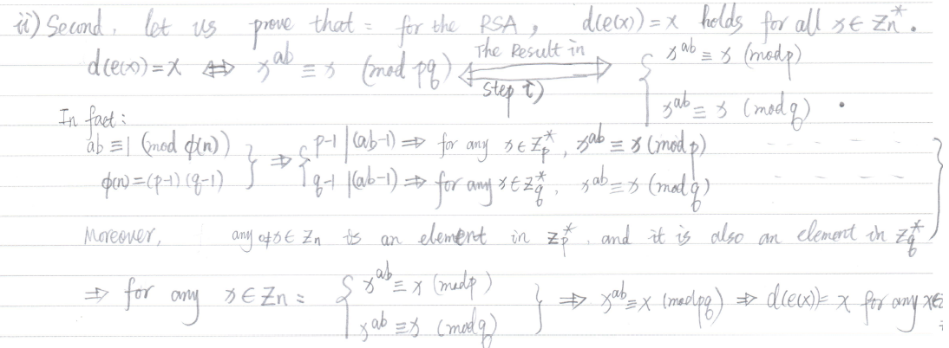
Homework 5
6.11 Proof:

Slide 23
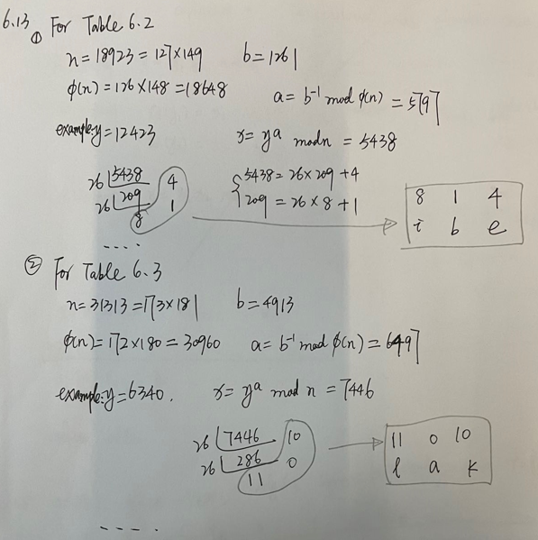
Homework 5
6.13

Slide 24
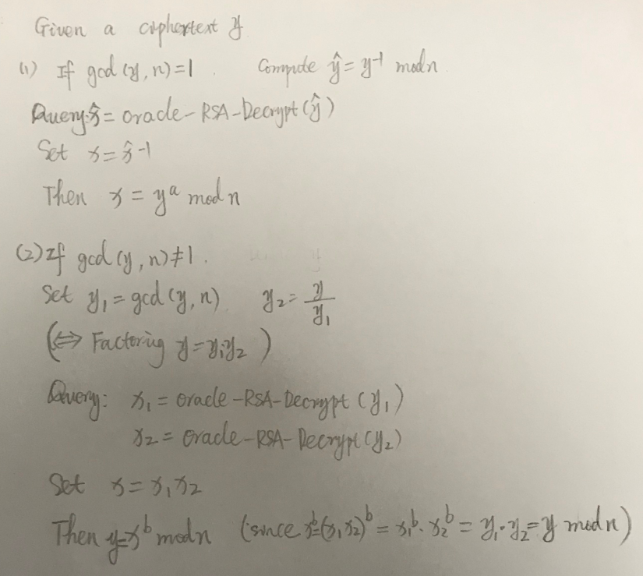
Homework 5
6.15

Slide 25
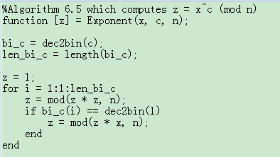
Homework 5
6.16 a) By Look-up Table
b) n = 18721, b = 25 = (11001)₂; use the square-and- multiply algorithm (Algorithm 6.5) to compute
x^{b} mod n for all x in Z₂₆ to generate the table as follows:
x | 0 | 1 | 2 | 3 | 4 | 5 | 6 | 7 | 8 | 9
y | 0 | 1 | 6400 | 18718 | 17173 | 1759 | 18242 | 12359 | 14930 | 9
x | 10 | 11 | 12 | 13 | 14 | 15 | 16 | 17 | 18
y | 6279 | 2608 | 4644 | 4845 | 1375 | 13444 | 16 | 13663 | 1437
x | 19 | 20 | 21 | 22 | 23 | 24 | 25
y | 2940 | 10334 | 365 | 10789 | 8945 | 11373 | 5116
365, 0, 4845, 14930, 2608, 2608, 0 VANILLA

Slide 26
Homework 6
7.1
Understand the idea of Shank’s Algorithm
Implement Shank’s Algorithm with Matlab codes named “Shanks.m”
log₁₀₆ 12375 = 22392 (mod 24691)
log₆ 248388 = 232836 (mod 458009)

Slide 27
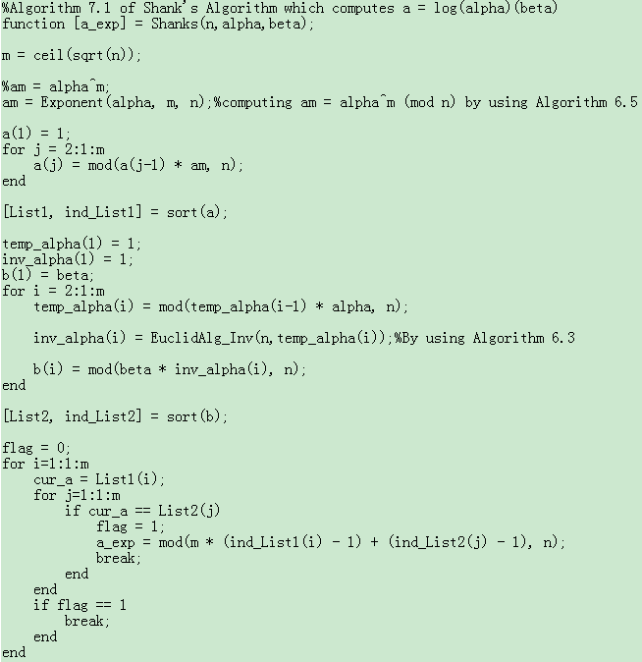
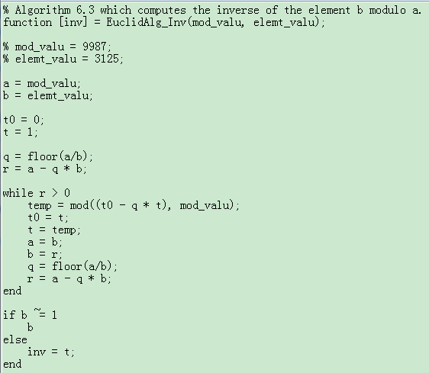
Homework 6
7.1
Understand the idea of Shank’s Algorithm
Implement Shank’s Algorithm with Matlab codes named “Shanks.m” (see the codes in PDF document)
log₁₀₆ 12375 = 22392 (mod 24691)
log₆ 248388 = 232836 (mod 458009)

Slide 28
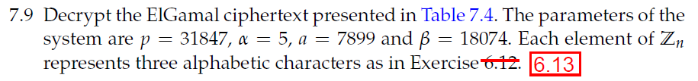
Homework 6
Answer: basic idea: For the ElGamal Cryptosystem
ElGamal Encryption & Decryption
Enc(x) = (y₁, y₂): y₁ = α^{k} mod p and y₂ = xβ^{k} mod p
x=Dec(y₁, y₂) = y₂(y₁ª)⁻¹ mod p
Represent x in 26-ary as x=(bcd)₂₆ where x = b*26² + c*26 + d and b, c, d are in Z₂₆, then the plaintext can be obtained.
System setup: p=31847, α=5, β=18074, a=7899
For example: (y₁,y₂)=(3781, 14409)
x =y₂(y₁ª)⁻¹ mod p = 14409 * (3781⁷⁸⁹⁹)⁻¹ mod 31847
then x=(x₁ x₂ x₃) satisfying x= x₁ * 26² +x₂ *26+x₃ where x_{i} is in{0,1,…, 25} ←→{A,B,…, Z}

Slide 29
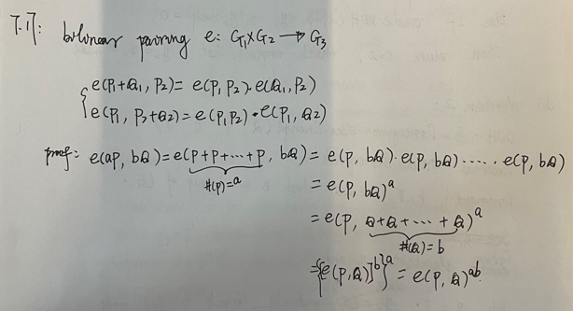
Homework 6
7.17

Slide 30
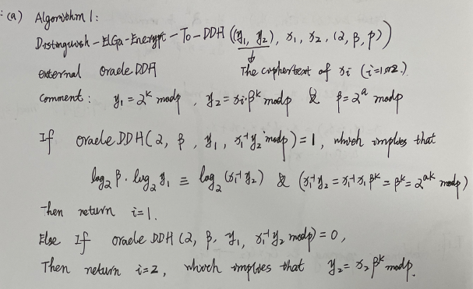
Homework 6
7.23

Slide 31
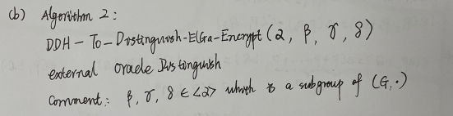
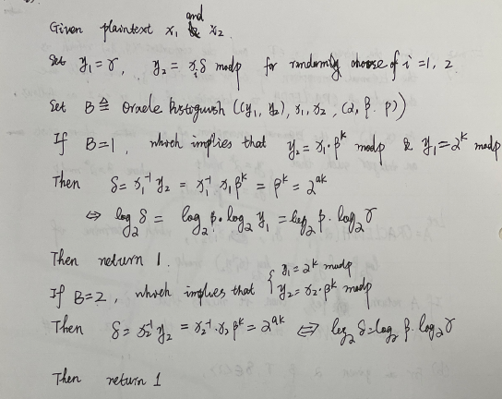
Homework 6
7.23

Slide 32
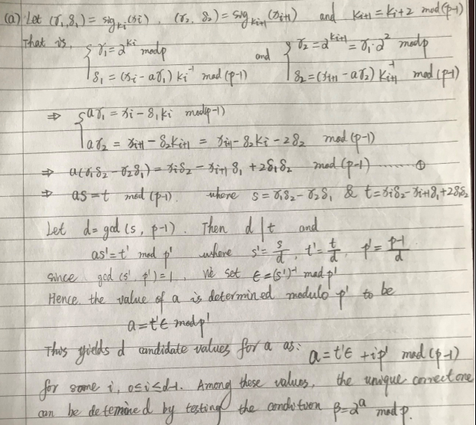
Homework 7
8.3

Slide 33
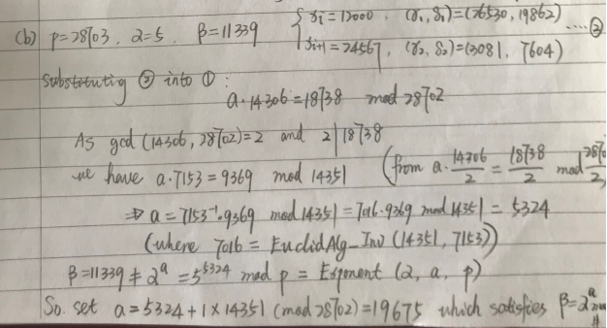
Homework 7
8.3

Slide 34
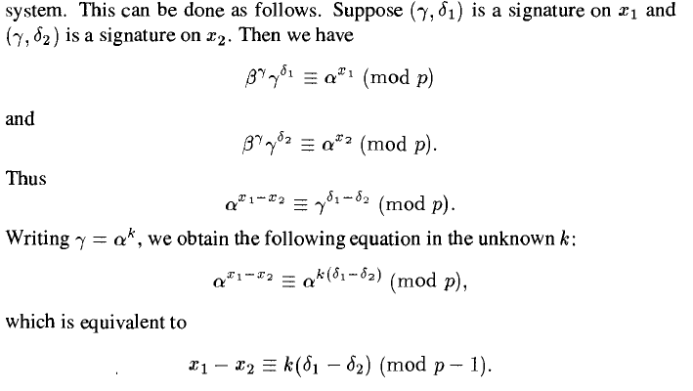
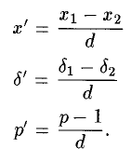
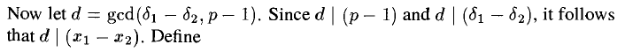
Homework 7
8.8 (for ElGamal Signature Case)
If the same k is used to sign two different messages.
Verification: ver_{pk}(x, (γ, δ)) = true ↔ β^{γ}γ^{δ} ≡ α ^{x} (mod p)
Notes:
If a is known, the system is completely broken.
If a is unknown, let us try to forge a signature for a given x. We find that:
There exist an existential forgery under a key-only attack, and an existential forgery under a known message attack.
Moreover, the ElGamal signature can be broken if it is used carelessly. If the random value k used in signing is revealed, or the same k is used to sign two different messages, then the secret key a can be computed and the system is completely broken.

Slide 35
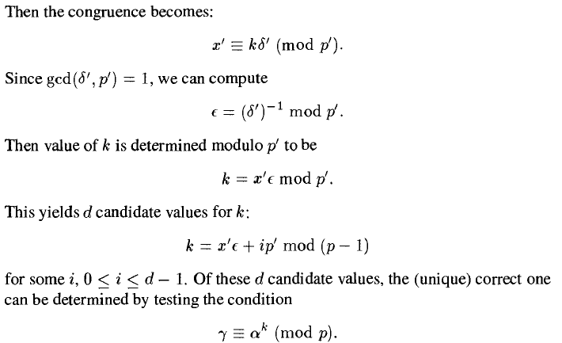
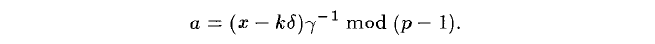
Homework 7
8.8 (for ElGamal Signature Case)
If the same k is used to sign two different messages.
Notes:
If a is known, the system is completely broken.
If a is unknown, let us try to forge a signature for a given x. We find that:
There exist an existential forgery under a key-only attack, and an existential forgery under a known message attack.
Moreover, the ElGamal signature can be broken if it is used carelessly. If the random value k used in signing is revealed, or the same k is used to sign two different messages, then the secret key a can be computed and the system is completely broken.

